Slide 1
Intelligent User Experience
Developing a child-driven online education environment for third world countries

Slide 2
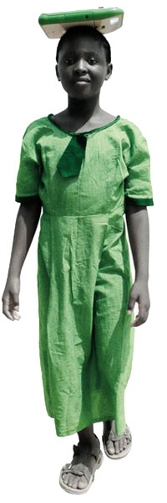
Recap
Problem and solution
Problem: education in third-world countries lacks experienced teachers and study materials.
Solution: Online Learning Environment focused on group learning and encouraging social interaction.
Usage of an avatar exploiting “ the granny effect”.
Usage of One Laptop Per Child platform is assumed.

Slide 3
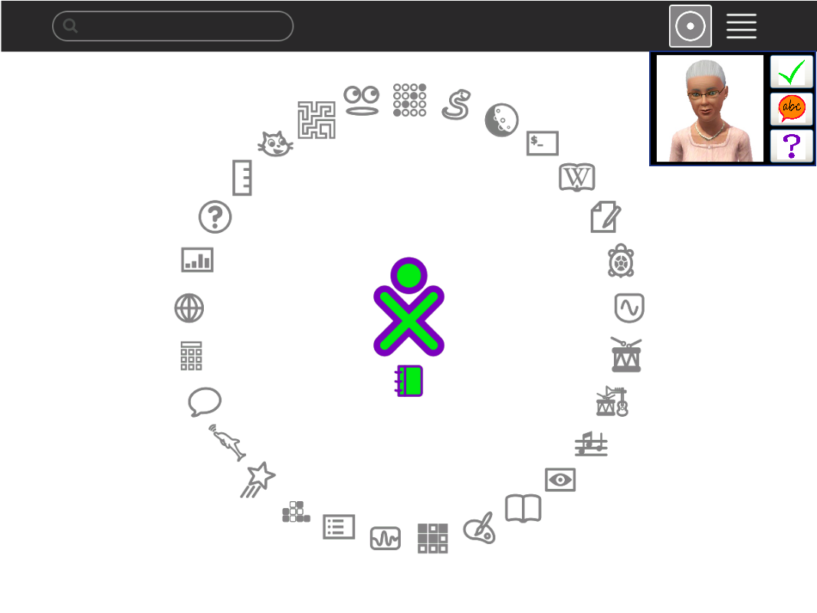
Interface: student view

Slide 4
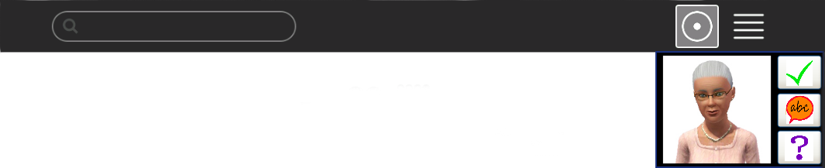
Interface: student view
An avatar is integrated into the system and is always available to provide assistance.
Student may use all the installed software while simultaneously working with the avatar.
Application GUI consists of 3D-picture of a person and buttons for communication.
Avatar is communicating with the students by suggesting tasks for completion and encouragement. The tasks are provided by the teachers.

Slide 5
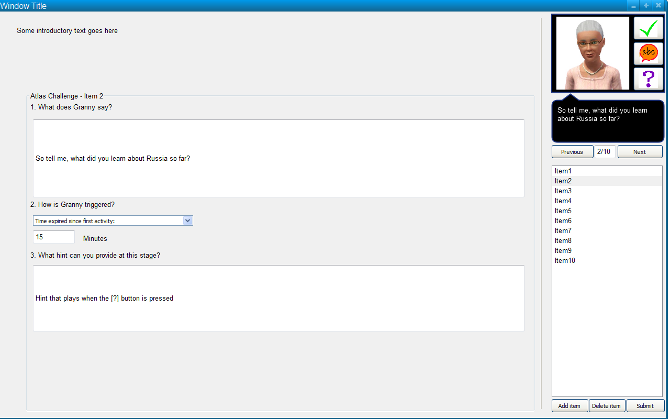
Interface: teacher view

Slide 6
Interface: teacher view
Teachers have a web-based application that allows to create activities for the students.
Creation of activities is done with the web forms. Also, teachers have access to the simulator of a student view to see how their activity will be displayed at the student PC.

Slide 7
Internals
Student application has an administration module for tasks management that allows to select set of tasks to provide students based on the filtering mechanism.
Student application settings can be changed remotely if a laptop is connected to the Internet.

Slide 8
Testing stages
Pre-design stage: create a set of sample activities on paper to analyse how the system should react on them.
Post-design stage:
  Create a mock-up of a system with the sample activities entered and test it on a focus group of young.
  Create a mock-up of a teacher system and test it on a focus group of school teachers.
  Gather feedback (observational and survey evaluation) and proceed accordingly.

Slide 9
Testing procedures
Create set of sample activities for students
Inform participants about the test
Experiment:
  For students: provide students with laptops with system run and evaluate their behaviour, record video
  For teachers: ask them to create an activity and fill the forms to enter it into system
Evaluation: questionnaire/interview

Slide 10
Testing claims
The avatar motivates the user to learn about a certain topic and asks questions that allow the user to reflect back on his progress thus improving learning.
Using the tool the user gains more knowledge about the world and understands it better.
Working in groups may increase the learning rate as this introduces a social aspect as well.

Slide 11
Testing objectives
Evaluate the approach: are young children in principle able to study by themselves using the computer and our assistant?
Detect usability problems: how do children and teachers interact with the application? Is it done in the predefined way? What functionality do they miss?

Slide 12
User experience measurements
Encouragement: do students find it interesting to work with the program and like completing tasks?
Usability: do students and teachers feel themselves comfortable while working with the system or it is counter-intuitive/complex/etc.?
Group work: do students find it more educational/fun to work in groups?

Slide 13
Basic data analysis
Quantitative analysis of completed tasks: how many tasks were completed by students within the given time frame?
Quantitative analysis of avatar benefits: how do results improve if using avatar if comparing with merely textual interaction?

Slide 14
Advanced data analysis
Quantitative analysis of students involvement: how many students decided to keep working with program on spare time?
Quantitative analysis of group learning: groups of what size perform better?
Qualitative analysis of submitted tasks: how well do teachers understand the requirements for the new tasks?
Quantitative measurements of different avatars: how do such characteristics as the gender, age and pose of the avatar affect the results?

Slide 15
Unresolved challenges
Feedback retrieval.
Guidelines for creating tasks. The tasks in a system should have a solution with the available tools and contain encouragement for a student to start working on assignment.
Localisation issues. As our setup is different from what Sugata Mitra uses, we apparently cannot stick to English only. There should be a way to translate activities and filter them by language.

